Slide 1
Game Development Tips
Software Studio 軟體設計與實驗
Hung-Kuo Chu
Department of Computer Science
National Tsing Hua University
CS2410
Notes:
What this document is about:
Making you spend more time actually making the game and less time trying to synchronize with your teammates.
Reducing the amount of time wasted on wrestling with metadata issues in a game engine.
What this document is NOT about:
Game design (Very important!)
Clean code (Still important!)

Slide 2
Outline
Motivation
Serialization problems
Introduction to game engine serialization and the merge conflicts they may cause.
Merging
Game architecture to make merging trivial.
Rollback
Using Git to save your project from peril.

Slide 3
Before we start…
If you are still afraid of using Git because the command line interface scares you…
VS Code’s Git integrations and GitHub Desktop (see Appendix) are both GUI that can simplify the process!
Don’t give up on Git yet! You can’t run from it forever, so take this chance and start now!

Slide 4
Motivation
You’re a group of programmers working on the same game.
You must work together, but what are the implications?
Communication overhead
Time spent on getting ideas across each other.
Synchronization overhead
Time spent on waiting for another person, and time spent on merging changes from different people.

Slide 5
Motivation
You can reduce time spent on waiting by increasing the degree of parallelism.
More people working on separate modules that can be designed separately.
This just requires good planning.
But with increased parallelism, you’ll have to deal with greater synchronization overhead.

Slide 6
Motivation
Students in the past years have faced serious troubles with this overhead.
One group reported to have encountered over 700 lines of merge conflicts.
We will teach you how to plan your workflow and software architecture to avoid those nasty problems!

Slide 7
Version Control
In the first two weeks of this course, we introduced version control with Git, which helps us develop software asynchronously.
It is important to remember that Git is designed with human-written code in mind.

Slide 8
Version Control
But, in a game project, there are large binaries (.png, .wav, etc.) and computer-generated data, the latter of which does not work well with most VCS.
That doesn’t mean you shouldn’t use Git – It’s the best choice available, but there are important things to watch out when using it.
Notes:
Note: Git is notably bad with large binaries, requiring the Git LFS service to handle files of size greater than 100MB. Other VCS fare better against them, but metadata are still generally problematic.

Slide 9
Project Structure
The project structure of a video game differs greatly from other software.
While they all have a lot of code in it, game projects also have complex serialized data which need to be read by the underlying game engine.
These data are the primary cause of hard-to-resolve merge conflicts and cryptic bugs.
Notes:
Note 1: You can avoid serialized data by hard-coding every property into your scripts and creating your scene entirely from a script. This is, of course, very messy, but for simple scenes it’s sometimes an option.
Note 2: Hard-to-resolve and cryptic because those data aren’t directly created by the developers in the project, mentioned later.

Slide 10
SERIALIZATION PROBLEMS
“It says my scene has merge conflicts, but I don’t know what any of the lines mean…”

Slide 11
Serialization
Most game engines produce serialized metadata (.meta) for whatever asset you import into it.
Scenes (.fire) and prefabs (.prefab) are also serialized data a game engine reads to create objects in the game.
A common format used is the JavaScript Object Notation (JSON), which is for the most part human-readable.
Notes:
Note 1: JSON is a strict subset of JavaScript (after 2019). A JSON string can be directly translated into a JavaScript object by a JavaScript interpreter, with no preprocessing needed.
Note 2: Asset metadata notably contain import settings and identifiers (UUID).

Slide 12
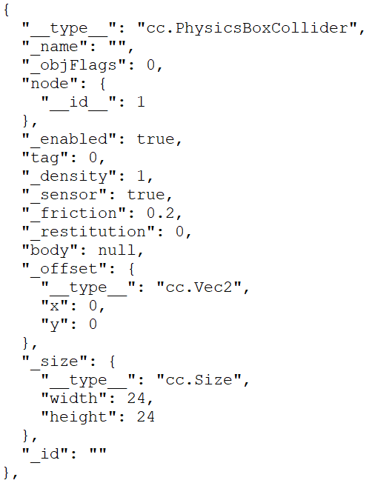
Serialization Example
This JSON segment is describing a component of type “cc.PhysicsBoxCollider”
These fields below would then correspond to its properties, which you would usually edit through the editor GUI.
Notes:
Note:
Serialized data: Organized in terms of a series of bytes that can be stored or transmitted to be reconstructed later.
A uniform 2D array (a contiguous array of integers with indices interpreted as a 2D array, for example) is serialized.
JSON objects are serialized because they’re just strings. They don’t contain runtime information.
Non-serialized data: Usually runtime objects. They’re non-persistent and contain references to runtime information such as pointers.
A jagged 2D array (array of integer pointers, for example) isn’t serialized.

Slide 13
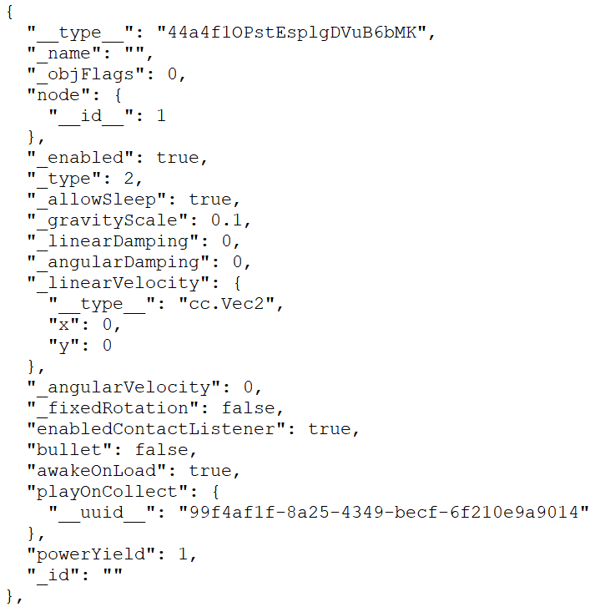
Serialization Example
This JSON segment is describing a component of type???
This might be referring to an audio clip, but which one?
Notes:
Note: This is a script for a collectible item, inheriting from cc.Rigidbody.

Slide 14
Serialization
The game engine recognizes assets and custom components in terms of unique identifiers, assigned when you import them into the project through the editor.
You can see these identifiers in the .meta files.
It will then refer to them through these identifiers in a scene or a prefab’s data.
This presents a source of conflict.

Slide 15
Serialization Conflict
Suppose that Alice and Bob are working together on a game.
Bob drew some sprites (.png) in his favorite painting software and used “Save As” to put them into the project. He then pushed the changes.
Alice received the changes, opened the project in the editor, and caused the editor to assign identifiers to those sprites.

Slide 16
Serialization Conflict (Cont.d)
Some time later, Bob opened the project again, and generated identifiers for his sprites. Alice told him that she had just integrated the sprites into a scene, and that she had pushed the changes.
Bob then pulled the changes, only to be met by multiple merge conflicts over the metadata of the new sprites.

Slide 17
Serialization Conflict (Cont.d)
What happened here is that Bob and Alice managed to generate two different sets of identifiers for the new sprites Bob had made.
When Alice pushed the changes made to the scene, the scene’s metadata refers to those sprites in terms of the identifiers in Alice’s branch.

Slide 18
Serialization Conflict (Cont.d)
In this simple case, Bob should use Alice’s version, but things could get tricky if Bob had made other changes in the meantime, or if they had been working with a third person.

Slide 19
Serialization Conflict (Solution)
To avoid this situation altogether, Bob should’ve pushed the identifiers alongside the new sprites.
To ensure that this is always the case, Bob should intentionally trigger the game engine’s import process by moving the new sprites’ files into the project through the editor.

Slide 20
Class Serialization
Another big issue with serialization comes from converting a class definition into a script component.
Internally, custom components must be registered to / unregistered from the project’s records. This is done when the script containing the component is first imported. (Usually upon creation)

Slide 21
Class Serialization (Solution)
If you modify the component’s name or delete it outright without the game engine’s supervision, it might not be able to detect the changes and change the metadata accordingly, resulting in error messages that wouldn’t go away.
For maximum safety, when removing a component or changing its name, you should always do it through the editor.
Notes:
Note: These errors vary in intensity (your project might still compile successfully), but it’s extremely hard to fix once they appear.

Slide 22
Merging
I merged your branch with mine and everything broke…

Slide 23
Merging
In game development, merging branches can be very problematic, precisely because of the metadata changed through the editor.
Without proper planning, solving merge conflicts can waste hours of your precious time and introduce unwanted bugs.

Slide 24
Naïve Merging
Suppose that Alice and Bob are editing the same scene at the same time. They agreed not to change what was already in the scene.
Alice added some UI components, while Bob added some sprites to the scene.
And then, Alice pulled from Bob’s branch directly, merging the changes.
Is this enough to avoid merge conflicts? No!

Slide 25
Naïve Merging
Now, Alice must resolve the merge conflict.
She peeked at the scene’s metadata and found hundreds of lines in conflict.
She could edit it herself, manually reconstructing the merged version by rearranging the JSON objects.
But it’s error prone and a waste of time.
If one of them had rearranged the scene’s node tree, this would be even harder to do!
Can we do better?

Slide 26
Better Merging
This time, Alice and Bob agreed to implement their changes in separate scenes.
After they’re both finished, Alice pulled from Bob’s branch, and received Bob’s scene.
Following Bob’s instructions, Alice copied the nodes in Bob’s scene and pasted them into her own scene, completing the merge.
No metadata editing was needed.

Slide 27
Better Merging
Why does this work?
Alice and Bob’s scenes are mutually exclusive.
Merging the two scenes is done manually through the editor in a third scene, which only one person will edit at a time.
Therefore, no merge conflicts!

Slide 28
Even Better Merging
With good planning, we can eliminate the need for manual merging altogether.
This time, Alice and Bob agreed to put their changes under their corresponding prefabs.
Alice put a script in the scene, which will instantiate their prefabs when the scene loads.

Slide 29
Even Better Merging
const {ccclass, property} = cc._decorator;
@cclass // Place this component on a node in the scene.
export default class MainSceneManager{
@property(cc.Prefab)
UIPrefab: cc.Prefab = null; // Assign by drag-and-drop.
@property(cc.Prefab)
actorsPrefab: cc.Prefab = null; // Assign by drag-and-drop.
// …

Slide 30
Even Better Merging
onLoad(){ // Construct the full scene.
let UI = cc.instantiate(this.UIPrefab);
let actors = cc.instantiate(this.actorsPrefab);
UI.parent = cc.Canvas.instance.node;
actors.parent = cc.Canvas.instance.node;
// PlayerController can now use cc.Canvas.instance.node.find(“UI”)
// to get the node that has UIManager attached.
}
}

Slide 31
Even Better Merging
With this method, there is no need to edit the scene anymore. Merging can happen without generating any conflict.
The only downside is that they cannot preview how the final scene looks. They have to enter play mode to see the combined results.

Slide 32
Even Better Merging
Is not being able to see the final scene in the editor that big of an issue?
The editor is most useful for adjusting visual parameters, like position, scale, rotation, etc.
These parameters can be edited inside the prefabs, rather than in the scene view.

Slide 33
Dependencies
It is important to note that the task of merging Bob’s scene into Alice’s scene is trivial because they have no mutual dependency yet. Bob does not need anything from Alice’s scene, and vice versa.
Furthermore, they both don’t need anything from the original scene.
In software engineering, a dependency means that one object references another.
Notes:
Note: Dependency between objects inside the same project is called “internal dependency”, a type of dependency you have full control over. External dependency refers to dependency over external API (such as three.js and the Firebase API, which are out of your control). We only discuss internal dependencies here.

Slide 34
Dependencies
Identifying dependencies when planning your project can help you break a project into smaller chunks of work which can be worked on separately.
However, most objects have at least a few dependencies.
In the case of Alice and Bob, Bob might need to reference Alice’s UI scripts, telling them the player’s current HP and lives.

Slide 35
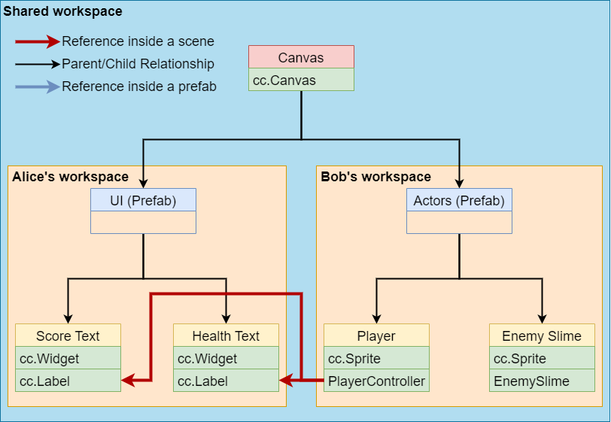
Dependencies
The scene hierarchy would look like this:
Bob needs to enter Alice’s workspace!
Notes:
Note: This is not necessarily the best way to implement HUD functionalities. One might prefer to have additional components that handle translating the player’s HP and score (Numbers) into formatted strings, rather than letting PlayerController implement those functionalities. There is no right or wrong here, though.

Slide 36
Dependencies
It seems that Bob needs to assign the reference to Alice’s UI using their nodes’ paths. (with cc.find)
This would violate encapsulation between the two modules – Bob needs to know about the structure of Alice’s prefab.
If Alice renamed any node on the path or changed her prefab’s node tree, Bob’s scripts would suddenly start failing to find the references.

Slide 37
Abstraction
That Bob needs to inspect Alice’s prefab indicates that there isn’t enough abstraction between the two prefabs.
An abstraction layer can hide implementation details with indirection, becoming a “middleman” across multiple objects.

Slide 38
Abstraction
To maintain encapsulation, Alice could collect all references Bob might be interested in into one component, preferably placed in the prefab’s root.
Bob could then retrieve the references from that component, rather than exploring Alice’s prefab’s node tree.
We say that the component abstracts the exact locations of the references.

Slide 39
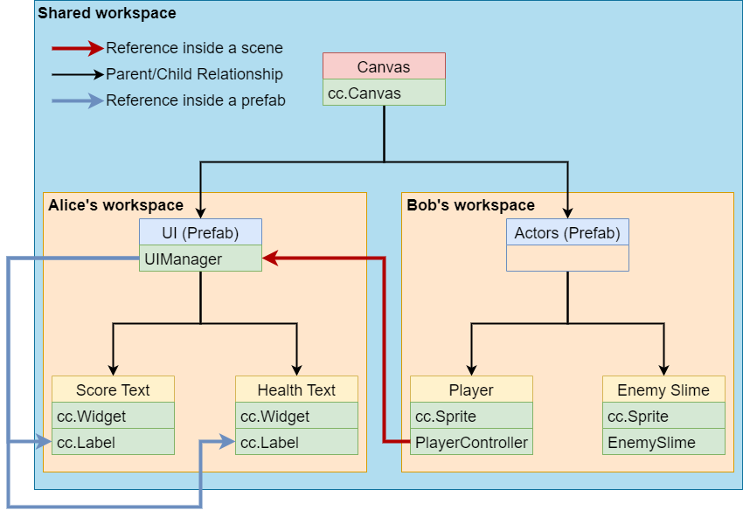
Abstraction
Notes:
UIManager is an abstraction layer over Alice’s prefab.

Slide 40
Abstraction
Now Alice just needs to maintain the UIManager’s references on her own, and Bob does not need to know about the exact locations of the Score and Health Texts.
However, Bob still needs to reference UIManager by the instance of Alice’s prefab in the scene. (Again, with cc.find)
With one more layer of abstraction, Bob can avoid checking the scene’s node tree altogether!
Notes:
Note: Alternatively, you can make UIManager a singleton (class with exactly one instance, accessible through a static variable). Singletons should be used with care, however, like other design patterns in the Gang of Four.
The approach shown here has an advantage over the singleton approach in that it is immediately obvious that Bob’s prefab depends on a reference to UIManager, whereas in the singleton approach one would have to check every component in Bob’s prefab to identify the dependency.
Furthermore, Bob would be able to test his changes’ functionalities in a separate scene with a simplified UI by plugging the prefab into that scene and connecting to that scene’s UIManager, all without waiting for Alice.

Slide 41
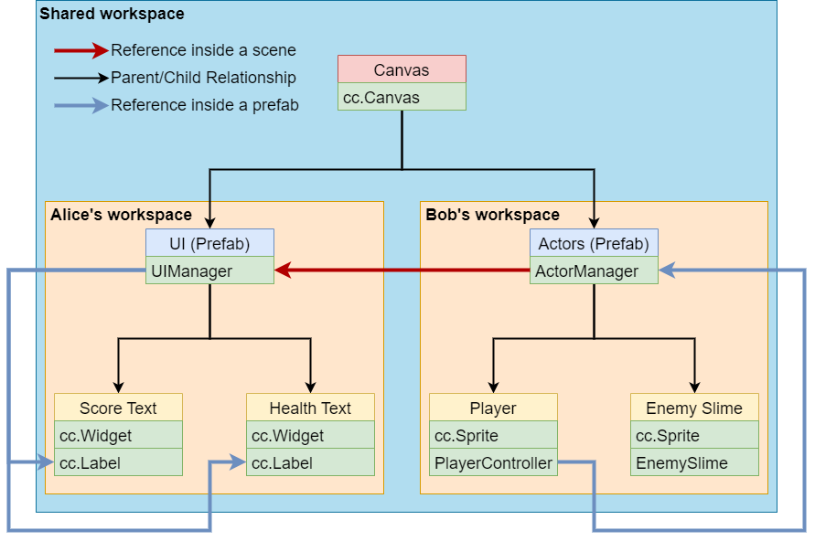
Abstraction
Notes:
ActorManager is an abstraction layer over Bob’s prefab’s external dependencies.

Slide 42
Abstraction
// In MainSceneManager:
onLoad(){ // Construct the full scene and resolve references on load.
let UI = cc.instantiate(this.UIPrefab);
let actors = cc.instantiate(this.actorsPrefab);
UI.parent = cc.Canvas.instance.node;
actors.parent = cc.Canvas.instance.node;
actors.getComponent(ActorManager).injectDependencies(
UI.getComponent(UIManager)
); // Give ActorManager the reference to UIManager
// Now PlayerController can reference UIManager through
// ActorManager, all inside the Actors prefab.
}
Notes:
Note: “injectDependencies” could just be a public method that just assigns the given UIManager to a private property.

Slide 43
Abstraction
With this model, Alice and Bob could connect ActorManager and UIManager right when their prefabs are instantiated.
Even if the actual objects they’re referencing don’t exist yet, these intermediate references can be connected beforehand!
This could even be the job of a third person, who doesn’t need to know the exact structure of the two prefabs’ hierarchies.

Slide 44
Abstraction
It is true that with abstraction layers in the way, PlayerController needs up to three references to access the cc.Label components (as opposed to just one without), possibly causing a performance penalty.
This can be mitigated by caching the references inside PlayerController.

Slide 45
Divide and Conquer
It is now apparent that organizing scenes in terms of prefabs can greatly reduce the time spent on merging and accelerate development speed.
We can take this approach to break down prefabs into smaller prefabs as needed, so that more people can work without waiting for each other.

Slide 46
ROLLBACK
Solving the problem by pretending it didn’t happen.

Slide 47
Rollback
It is not uncommon for your game project to become beyond saving.
When your game engine crashes, some metadata may be corrupted.
There might be too many merge conflicts or bugs for you to solve after merging.
It’s important to realize that sometimes it’s faster and easier to rollback to an older version.

Slide 48
Discarding changes
If it’s just that your game engine crashed and corrupted some data, you can discard the files that were changed unexpectedly.
For git, you can use git checkout to discard uncommitted changes to a file.
git checkout -- <filename>
Git – git-checkout Documentation

Slide 49
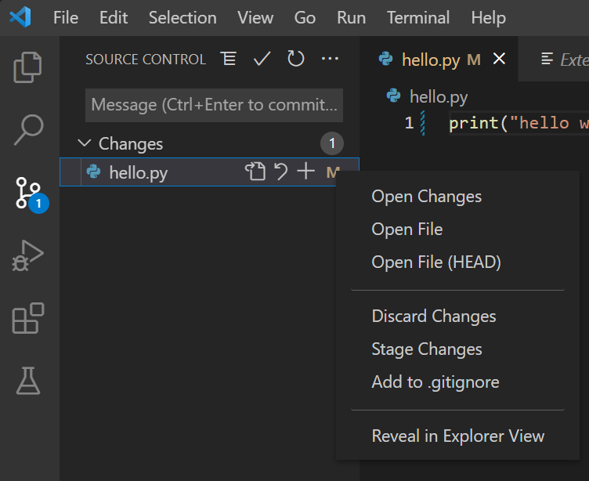
Discarding changes (VS Code)
1.
2. Right click the file
3.

Slide 50
Undoing commits
Usually, when something goes wrong, it’s because of a recent commit, such as the commit that comes from merging.
In VS Code, you can use the “undo last commit” button to put all changes back to the list of uncommitted changes, which you can then discard or keep.

Slide 51
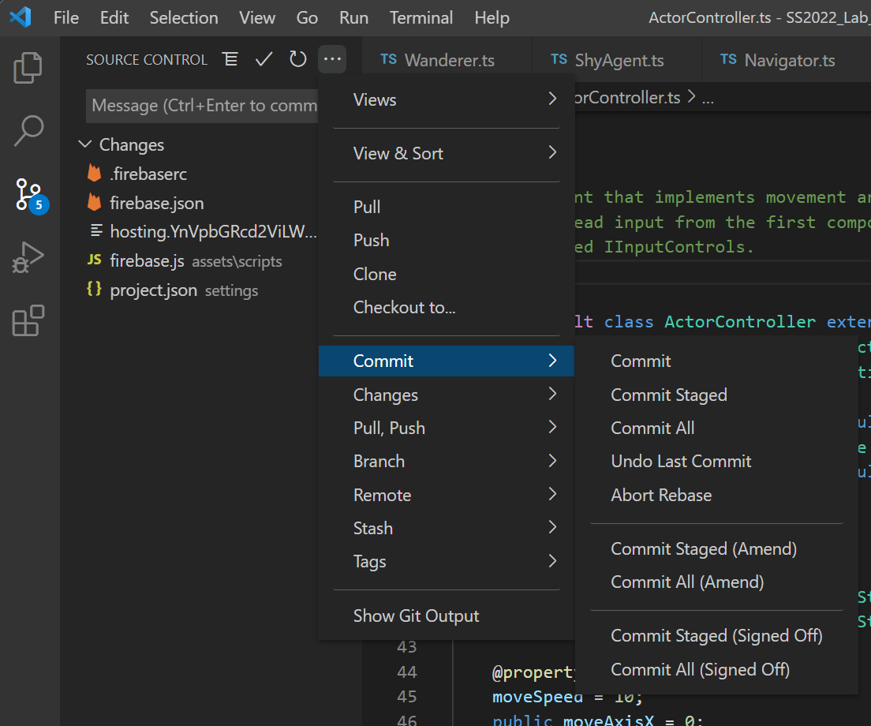
Undoing commits
2.
1.
3.
4.

Slide 52
Reverting commits
You can also use the more powerful git revert command, which can revert any commit, and not just the last one.
This will create a commit afterwards.
For VS Code, you’ll need extensions such as Git History or GitLens.
See the documentation for a detailed explanation.
Git – git-revert Documentation

Slide 53
Closing Notes
While this course is about making (frontend) software, it is not a course about software engineering, and so these slides only cover the bare minimum for small-scale development.
Consider taking the course Software Engineering (CS446100) to learn more about this topic.

Slide 54
Takeaways
Please use Git.
Only ever add files to the project through the editor GUI.
Avoid having more than one person modifying the same scene.
Break down a scene into independent prefabs and use abstraction layers to make merging trivial.
Notes:
懶人包

Slide 55





